Slide 1








Mentorness Internship Program
World Cup 2023
Data Analysis
By Vivek Ray

Slide 2

Introduction
Unlocking the secrets within cricket's grandest stage, our analysis delves deep into the statistics of the Cricket World Cup. Through rigorous data scrutiny, we aim to reveal patterns, trends, and insights that define the tournament's narrative. Join us as we dissect matches, players, and strategies to uncover the hidden dynamics of this celebrated sporting event. Welcome to a journey where data illuminates the path to cricketing glory.

Slide 3

Problem Statement
You are tasked with performing a detailed exploratory data analysis on the World Cup 2023 dataset. The goal is to uncover patterns, trends, and notable statistics that provide a delicate understanding of team and player performance. The analysis should encompass both batting and bowling aspects, considering key metrics such as runs, wickets, strike rate, economy rate, and other relevant factors.

Slide 4
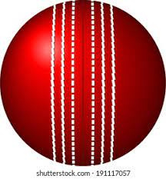
Analysis Done
Team Performance Analysis
Player Performance Analysis
Team Performance Analysis reveals top-performing teams and their strengths, analyzing metrics such as runs scored, wickets taken, and batting/bowling styles, offering strategic insights for future matches.
The player performance analysis unveils standout performers, highlighting leading run-scorers and wicket-takers, while also assessing their impact on team success. This scrutiny offers crucial insights into individual contributions within the Cricket World Cup.
Opposition and Ground Analysis
Temporal Analysis
Our temporal analysis reveals evolving performance trends over the course of the Cricket World Cup, capturing the dynamic nature of team and player performances with respect to start dates and overs played. This insight aids in predicting future trends and optimizing strategies for upcoming matches.
Our scrutiny of team performances against diverse oppositions and on varied playing grounds reveals nuanced strategic adaptations and performance disparities, offering valuable insights for future match strategies.

Slide 5
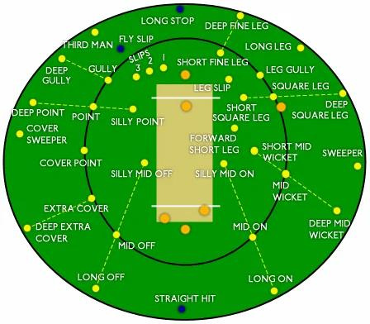
Conclusion
Through a meticulous analysis spanning team and player performances, opposition dynamics, and temporal trends within the Cricket World Cup, we've uncovered invaluable insights. From identifying top-performing teams and standout players to discerning strategic patterns against varied oppositions and grounds, our findings offer a holistic understanding of the tournament's dynamics. This comprehensive analysis serves as a roadmap for future strategies, enabling teams and enthusiasts to navigate the complexities of cricketing glory with data-driven precision.

Slide 6

Thank You
For Your Attention

